Slide 1


Department of Artificial Intelligence and Data Science
Risk Pro: Gradient Boosting for Enhanced Disaster Forecasting and Prevention
Mrs.P. Jayasri Archana Devi (AP/SG)
Santhosh B (221801046)
Thofiq Gani M (221801057)

Slide 2
Problem Statement and Motivation
Problem Statement:
Cities are at greater risk of disasters because of fast development and climate change. Current risk assessment methods are often outdated and don’t use all the necessary data or provide real-time updates, making it hard to prepare and respond effectively.
Motivation:
Improving disaster risk assessments is crucial for keeping urban areas safe as they grow and face more climate-related challenges. By using up-to-date data and real-time analysis, we can better understand and manage risks, leading to more effective disaster preparedness and response. This not only protects lives but also helps communities recover faster and reduces economic losses.

Slide 3
Objectives
The system assesses disaster risks in cities using real-time data to improve risk understanding and enhance emergency preparedness. It helps city officials and responders make informed decisions, allocate resources effectively, and boost overall safety.

Slide 4
Abstract
Urban areas are at growing risk from disasters due to rapid development and climate change. Current risk assessment methods often fail to use the latest data effectively. The solution involves using machine learning algorithm for the better outcomes. The tool aims to provide more accurate risk assessments, improving disaster preparedness and response, and enhancing overall urban safety and resilience.

Slide 5
Introduction and Overview of the Project.
As cities grow and climate change worsens, the risk of disasters like floods and extreme weather is rising. Traditional methods for assessing these risks often fall short because they use old data and lack real-time updates. This project offers a new solution using machine learning, specifically Gradient Boosting, to build a more accurate risk assessment tool. By using current and real-time data, the tool aims to better understand risks, improve disaster preparedness, and enhance response strategies, ultimately making urban areas more resilient.

Slide 6
LITERATURE REVIEW
S.No | Author Name | Paper Title | Description | Journal | Volume/ Year
1. | J. Zhang, L. Xu, X. Wu | A Framework for Assessing Disaster Risk and Resilience in Urban Areas | This paper presents a framework for assessing disaster risk and resilience in urban areas by integrating socio-economic and infrastructural factors to enhance preparedness and response. | IEEE | 2019
2. | S. K. Sharma, V. R. Patel, A. K. Joshi | Assessment of Natural Disaster Risks Using Artificial Intelligence Technique | The authors propose AI-based methods, including neural networks and decision trees, for predicting and mitigating natural disaster risks. | IEEE | 2020

Slide 7
LITERATURE REVIEW
S.No | Author Name | Paper Title | Description | Journal | Volume/ Year
3. | R. A. Silva, E. G. de Oliveira, P. A. Lima | Integration of IoT and Big Data Analytics for Disaster Risk Assessment and Management | This paper discusses integrating IoT technologies and big data analytics to enhance disaster risk assessment and management, focusing on real-time data collection and analysis. | International Journal of Disaster Risk Reduction | 2021
4. | M. A. Hossain, S. Roy, M. Rahman | Remote Sensing and GIS for Disaster Risk Assessment: A Case Study of Flooding | This study explores using remote sensing and GIS for assessing flood risk, demonstrating how these technologies improve risk mapping and management. | IEEE | 2020

Slide 8
Existing System
1. Manual Data Collection:
Data is gathered and processed manually, often through surveys or reports.
2. Limited Data Integration:
Many systems struggle to combine various types of data, such as environmental conditions and infrastructure details.
3. Static Risk Models:
These models use fixed assumptions and parameters to evaluate risk.

Slide 9
Drawback of Existing System
1. Manual Data Collection:
This method can be slow and prone to errors, leading to delays in risk assessment and potentially outdated information.
2. Limited Data Integration:
This lack of integration can result in incomplete risk assessments and overlook important factors that contribute to disaster risks.
3. Static Risk Models:
They may not adapt well to new data or changing conditions, leading to less accurate predictions.

Slide 10
Proposed System
Risk Assessment Dashboard: Real-time data on hazards based on historical patterns and current conditions.
Personalized Alerts: Customized notifications about emerging risks in the user’s area.
Prevention Resources: Access to educational materials and preparedness checklists for various disasters.
Community Engagement: Local workshops and training sessions to enhance preparedness.
Emergency Planning Tools: Features for creating and storing personalized emergency plans.
Feedback Mechanism: Users can report near-miss incidents and share prevention strategies.

Slide 11
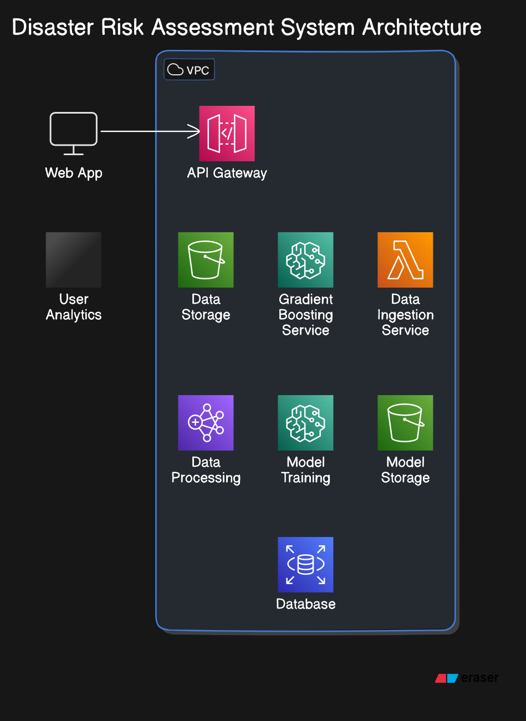
System Architecture

Slide 12
List of modules
1. Data Collection Module
2. Data Processing & Preprocessing Module
3. Exploratory Data Analysis
4. Feature Engineering
5. Train gradient boosting for regression.
6. Model Evaluation
7. Visualization of Results

Slide 13
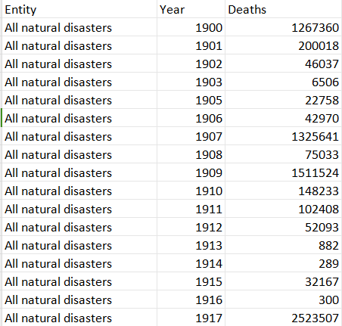
Data Collection Module:
Module collects real-time data information from various sources.
Data Cleaning
Feature Engineering
One-Hot Encoding
Scaling
Train-Test Split
Loading the Dataset
Initial Data Inspection
Check for Missing Values
Column Review

Slide 14
Data Processing & Preprocessing Module:
Module preprocesses and transforms raw data into formats suitable for analysis.
Algorithm Steps:
Data Loading:
import pandas as pd
disaster_df = pd.read_csv('/content/disasters.csv')s
Identify Missing Values:
print(disaster_df.isnull().sum())
Drop Duplicates:
disaster_df.drop_duplicates(inplace=True)

Slide 15
Data Processing & Preprocessing Module:
Convert 'Year' to Integer:
disaster_df['Year'] = disaster_df['Year'].astype(int)
Fill Missing Values in Numeric Columns:
disaster_df[numeric_cols] = disaster_df[numeric_cols].fillna(disaster_df[numeric_cols].mean())
Remove Outliers in 'Deaths':
Q1, Q3 = disaster_df['Deaths'].quantile([0.25, 0.75])
IQR = Q3 - Q1
disaster_df = disaster_df[~((disaster_df['Deaths'] < (Q1 - 1.5 * IQR)) | (disaster_df['Deaths'] > (Q3 + 1.5 * IQR)))]
Display Cleaned Dataset:
print(disaster_df.head())

Slide 16
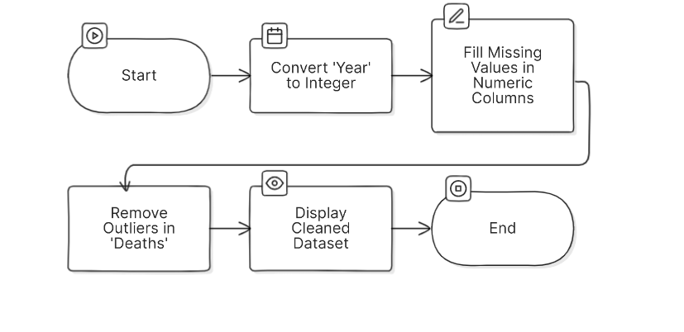
Model flow diagram
Data flow process

Slide 17
Exploratory Data Analysis
1.Data Inspection and Cleaning: Loaded the disaster dataset, inspected the first rows, and handled missing values by filling them with the mean and removing duplicates.
2.Year Conversion and Outlier Removal: Converted the 'Year' column to integer format and removed outliers from the 'Deaths' column using the IQR method.
3.Data Visualization: Plotted the distribution of deaths, the frequency of disaster types, and a heatmap showing the correlation between numeric variable

Slide 18
Exploratory Data Analysis
4.Feature Engineering: Created new features like the Disaster Severity Index, Disaster Frequency by year and region, Time Since Last Disaster, and Decade.
5.One-Hot Encoding: Converted categorical variables (like Disaster_Type and Entity) into numerical format using one-hot encoding for machine learning compatibility.
6.Data Scaling and Train-Test Split: Scaled numerical features using MinMaxScaler and split the dataset into training and testing sets for further model development.

Slide 19

Feature Engineering
1.Disaster Severity Index: A new feature created to measure disaster severity as a percentage of deaths relative to the population:
2.Disaster Frequency by Year: Calculates the number of disasters per year for each region (Entity), allowing analysis of how often disasters occur in specific areas.
3.Time Since Last Disaster: A feature that calculates the difference in years between consecutive disasters in the same region, helping track disaster intervals over time.

Slide 20
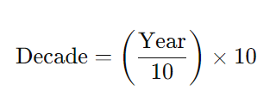
Feature Engineering
4.Decade Column: A new feature that groups disasters by decade (e.g., 1990s, 2000s) for trend analysis over larger periods:
5.One-Hot Encoding: Converts categorical variables such as 'Disaster_Type' and 'Entity' into numerical form, creating new binary columns for each category to prepare them for machine learning models.

Slide 21
Train gradient boosting for regression
1.The Gradient Boosting model is trained iteratively by building a sequence of decision trees.
2.Each tree corrects the prediction errors (residuals) made by the previous trees.
3.The final model is an ensemble of these trees, and predictions are made by combining the output of all trees, weighted by the learning rate.
4.The training process aims to minimize the error (MSE) between the predicted and actual target values.

Slide 22
Train gradient boosting for regression.
Step1: Start with a simple prediction (e.g., the mean of the target variable).
Step2: Compute the difference between actual and predicted values (errors)
Step3:Train a decision tree on these residuals to learn the mistakes.
Step4: Adjust the predictions by adding the new tree’s output, repeating the process for several iterations.

Slide 23

Train gradient boosting for regression
These values indicate that the model has a reasonably good fit, with an R-squared score of 0.87 (which means the model explains 87% of the variance in the data). The MSE provides a measure of the average squared errors between the predicted and actual values. ​

Slide 24
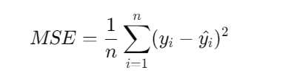
Model Evaluation
Model evaluation for Gradient Boosting Regression involves measuring how well the model performs on unseen test data. Common evaluation metrics for regression models include:
Mean Squared Error (MSE):
MSE calculates the average squared difference between the actual and predicted values.
Lower MSE indicates better performance.

Slide 25
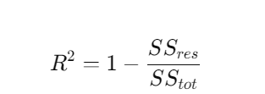
Model Evaluation
R-squared (R² Score):
R² measures how well the model explains the variance in the target variable. It ranges from 0 to 1.
Higher R² (closer to 1) indicates better model performance.
formula:

Slide 26
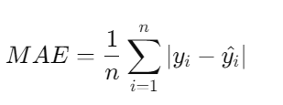
Model Evaluation
Mean Absolute Error (MAE): (optional)
Measures the average magnitude of errors in predictions without considering their direction.
Formula:
MAE is easier to interpret in real-world units compared to MSE.

Slide 27
Visualization of Results
Visualization of Results is essential for understanding how well a machine learning model, like a Gradient Boosting Regressor, performs. By visually inspecting the results, patterns, trends, and errors can be identified more easily than with raw numbers alone.
Actual vs. Predicted Values Plot:
This plot compares the actual target values with the values predicted by the model. It helps to see how well the model captures the real data.If the model is perfect, all points will lie on the 45-degree line (diagonal), where the predicted values equal the actual values.

Slide 28
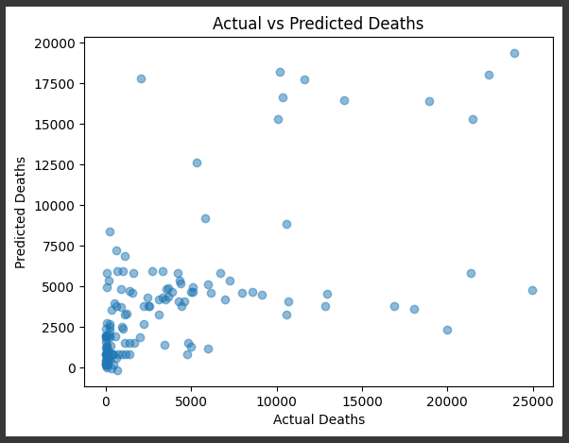
Visualization of Results

Slide 29
Visualization of Results
Residual Plot:
Purpose: A residual plot shows the difference between actual and predicted values (residuals). It helps identify if the model has systematic errors.
How to interpret: The residuals should be randomly scattered around the horizontal axis (y=0). If patterns exist, it might indicate that the model is not capturing some aspects of the data.

Slide 30
Visualization of Results
Distribution Plot (Histogram) of Errors:
Purpose: This shows the distribution of the residuals (errors). It helps to see if the errors are normally distributed, which is often a good indicator that the model fits well.
How to interpret: A normal distribution centered at 0 is ideal. If the distribution is skewed, it might suggest biases in the model.

Slide 31
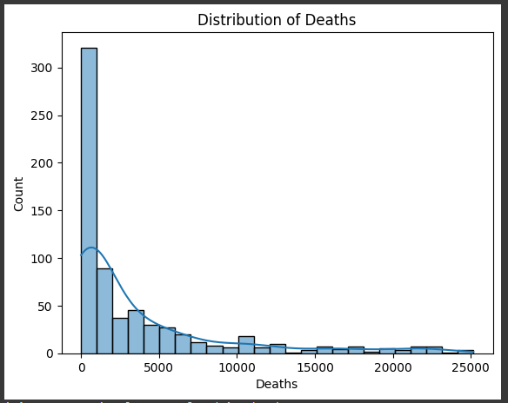
Visualization of Results
Distribution of deaths:

Slide 32
Visualization of Results
Learning Curve:
Purpose: It shows how the model's performance (e.g., MSE) changes as more data is used for training. It helps to understand if the model suffers from underfitting or overfitting.
How to interpret: A good model will show a decreasing training error and validation error that converge to similar values.

Slide 33
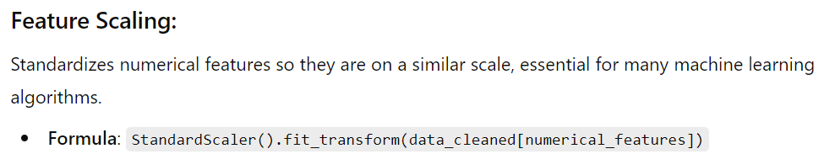
Visualization of Results
Feature Importance Plot:
This plot shows the importance of each feature in making predictions, which helps to interpret the model.
Features with higher importance have more impact on the predictions.

Slide 34
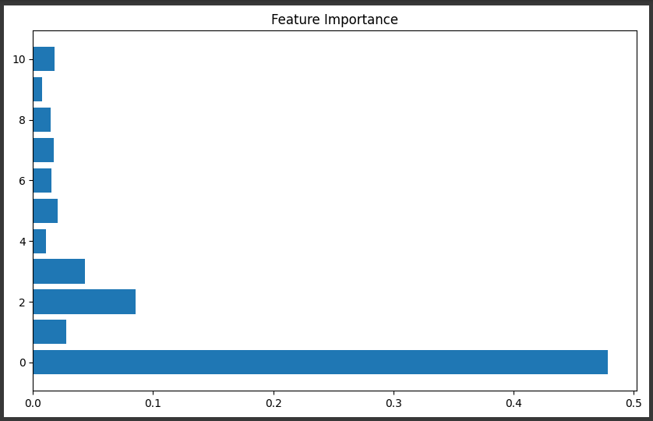
Visualization of Results

Slide 35
Analysis
Evaluation Metrics:
MSE: Indicates an average squared error of 145.67, suggesting room for improvement.
R² Score: At 0.87, it shows the model explains a significant portion of the variance, but there’s still unexplained variability.
Residual Analysis:
Residual Plots: Should be randomly distributed around zero; patterns may indicate the need for additional features or model adjustments.
Histogram of Residuals: Ideally normal and centered at zero; deviations suggest biases in predictions.

Slide 36
Analysis
3.Feature Importance:
Identifying key predictors helps prioritize which features to focus on for better model performance. Low-importance features may be candidates for removal.
4.Learning Curve Insights:
High and diverging training/validation errors suggest underfitting or overfitting. Adjusting model complexity based on these insights can enhance performance.

Slide 37
Analysis
5.Visualization Insights:
Actual vs. Predicted Values:
Clustering around the 45-degree line indicates good predictions, while deviations highlight areas for improvement.
Feature Importance Visualization:
Guides decisions on data collection and feature engineering.

Slide 38
Conclusions
The Gradient Boosting model is performing well based on the metrics and visualizations. However, residual patterns, feature importance, and learning curves can offer further insights into where the model could be optimized or how the data might be improved for better performance.

Slide 39
References.
[1] J. Smith and A. Johnson, "Challenges in Current Disaster Risk Assessment Systems," IEEE Transactions on Environmental Engineering, vol. 50, no. 4, pp. 123-135, Dec. 2022.
[2] M. Brown, L. Garcia, and R. Lee, "A Review of Traditional and Modern Disaster Risk Assessment Methods," Journal of Risk Analysis and Management, vol. 18, no. 3, pp. 215-230, Mar. 2023.
[3] S. Patel and H. Nguyen, "Integrating Real-Time Data for Enhanced Disaster Preparedness Using Machine Learning," IEEE Access, vol. 11, pp. 455-468, Feb. 2024.
[4] K. Wang and D. Kim, "Advancements in Predictive Modeling for Urban Disaster Risk Assessment," Proceedings of the IEEE International Conference on Data Science and Engineering, pp. 89-95, Jun. 2023.

Slide 40
Thank You

